Slide 1
Developing a Framework for Problem Solving Computer Coaches
Presenter: Evan Frodermann
University of Minnesota – Twin Cities
Collaborators: Qing (Xu) Ryan, Kristin Crouse,
Ken Heller, Leon Hsu, Jia-ling Lin, Bijaya Aryal
AAPT Summer 2013 Meeting
Portland, Oregon

Slide 2
From Version 1 (v1) to Version 2 (v2)
What do we want to retain?
Cognitive apprenticeship framework
Modeling, Coaching, Fading, Scaffolding
What do we want to improve?
A more flexible framework in which to build coaches.
Remove some of the technological limitations of the previous version.
We used instructor and student feedback to improve the design and structure of the coaches.
Notes:
We want to retain some fundamental features.
Microcosm of the overall problem solving structure of the course mimicked in the online coaches.
Not stand alone. These are intended to be a part of a full course with a course.
We want to improve them as well.
Modern intelligent tutors. We are using our knowledge of students and teaching from our previous extensive research in problem solving and molding our online coaches around these studies.
Not very intelligent as they don’t adapt to the students needs on demand. A more flexible framework will allow this to be true.

Slide 3
Motivation from Student Responses
Selected data from survey, End-term Spring 2013
The computer coaches did not help improve my problem solving in this class. (135 responses)
Selected data from survey, Midterm Spring 2013
Free response: What do you like least about the computer coaches?
“Too repetitive” or “too long”: 49% of the 183 responses
30 minutes
Free response: What do you like most about the computer coaches?
“Step by step” or “Guide beginning to end”: 23% of the responses.
Both free response categories were the most frequent.
 | Not Improve | Neither | Improve
H (65) | 21% | 12% | 67%
M (27) | 11% | 15% | 74%
L (43) | 34% | 24% | 41%
H: Heavy User (80-100%)
M: Medium User (40-60%)
L: Light user (0-20%)
Notes:
Some of the student feedback is from the surveys in Fall 2011 and Spring 2013.
Question from end term survey
Most students disagreed that the coaches did NOT help their problem solving in the class.
There seems to be need for these types of online coaches in problem solving based introductory physics class.
Free response questions from midterm Spring 2013
What do you like least about the computer coaches?
Too repetitive or too long were 49% of the responses.
What do you like most about the computer coaches?
Step by step or guide from beginning to end were 23% of the responses.
There seems to be a desire to streamline our coaches to shorten the time it takes.
Must be done in a way to not remove the desire for step by step guides through problems.
Must be done in a way that retains the problem solving pedagogy of the instructor.

Slide 4
Developing version 2
Better address the needs of the Heavy and Medium user population (Qing’s Talk)
H: encourage bypassing detailed coaching
M: adjust decision grain sizes
Notes:
Subpopulation
M _address perceived inefficiency
H _step by step if desired; encourage bypassing detailed coaching

Slide 5
Student Flexibility
Transparent student dictated solution paths.
Students are free to finish any part of the “unlocked” coach at any point.
More “human-like” coaching;
This is accomplished due to a shift towards object-oriented programming
Student adjusted grain size
Previous version either forced students into completing steps they may not need or did not give full detailed guide even if they desired.
Areas of the coaches are streamlined to reduce repetition
More detail can be accessed if desired to retain the “step-by-step” nature of the coaches.
Notes:
We have a framework which is more flexible than version 1 which adapts more of the problem solving pedagogy we would like to see in our online coaches.
Solution paths are open.
Students can choose to solve any unlocked path. How much is unlocked at a given time or from a given question is dictated by the instructor.
Going to more human-like coaching.
Students aren’t immediately locked into a particular choice
Adjustable grain size
Students work on problems on their own and turn to coaches for assistance.
Some V1 coaches forced the students to start from the beginning regardless of previous progress in the coach or outside of the coach.
Some v1 coaches forced the student to have a near complete idea of the problem and brought them into a specific area of issue when prompted.
There is no middle ground. The new version will bridge the gap by having adjustable grain sizes.

Slide 6
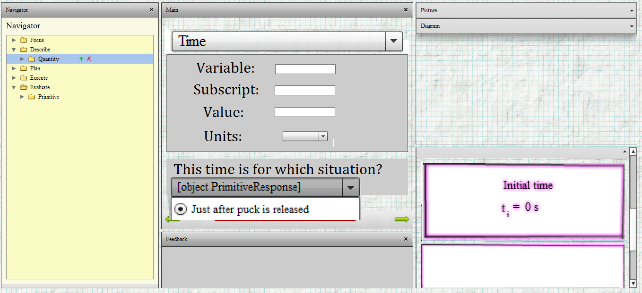
Grain-size with Quantity Module
The quantity module is a small example of this “grain size”.
Students choose which ones to define. Only minimal set required.
More quantities (specifically those associated with other solution paths) can be defined depending on what students want to define.
Quantity categories are defined by instructor which include a list of required responses.
Quantities required to solve the problem must be defined. Other quantities can also be defined.
Students choose which quantities to define with these minimal responses.
Notes:
Example of adjustable grain sizes to reduce repetition
Quantity module.
Quantities are defined at once (or in chunks). Students choose which quantities to “unlock”. Only the minimal set for their solution is required.
Each solution path will have different quantity requirements.
Students choose what variables to use (and definitions) which connects closer to their own preferences.

Slide 7
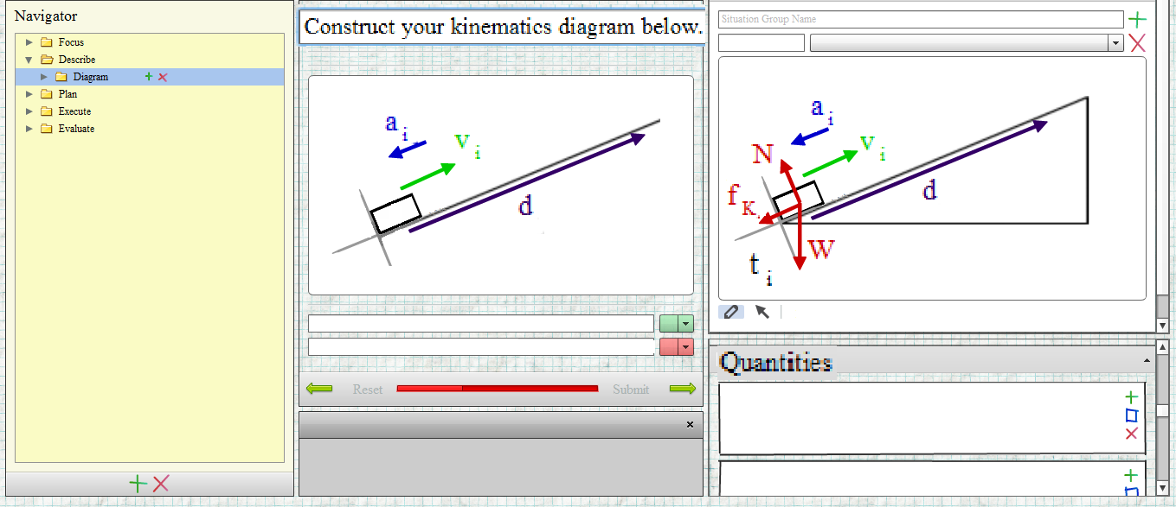
Instructor Flexibility
The individual elements of the coach are easier to edit.
No flash programming needed. Everything is edited in a graphical interface.
Instructors can choose to add or remove forces, add objects, change colors, shapes, etc. to their diagrams based on their own structure.
Picture elements are added to the database through the interface menus.
Diagrams are constructed by dragging elements from the picture into the diagram box.
Instructors edit pictures and diagrams within the GUI.
Notes:
To improve the instructor flexibility with using the program is associated with how the actual elements acted in version 1.
Previously, if variable names, colors, elements (do you want Earth as part of your picture) were not what was desired by the instructor, it was difficult to change.
Required flash programming
We now allow this flexibility with version 2.
Example: Pictures and diagrams are created and edited within the GUI.
Elements are added through the interface.
All pictures can be changed to cater to the instructor’s needs

Slide 8
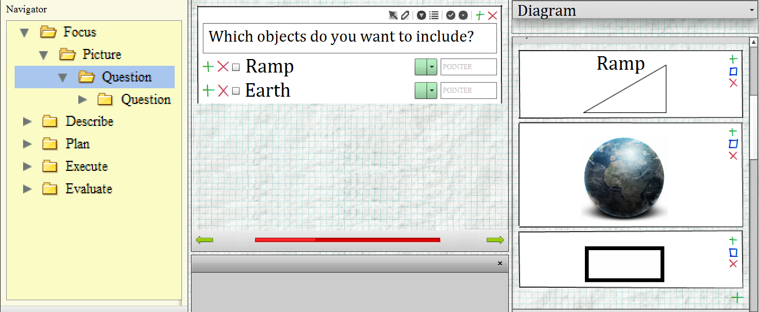
Problem Solving Philosophy
Previously, pedagogical changes/rewrites amounts to completely rewriting the software.
The instructors can adapt the coach solving structure using the graphical interface to fit the needs of their own course.
Users navigate to different “parent” elements at any time through this menu.
“Primitive” elements are unlocked for the student after correct responses.
“Children” elements are only unlocked for the student with correct responses to questions.
Notes:
Beyond just changing elements of the coach which is possible with a lot of effort, changing the structure of the coach was impossible.
The GUI in version 2 allows the instructor to tailor the coaches to their own needs.
The prebuilt coaches will follow this model, but they will not be locked to this structure.

Slide 9
Conclusions
Version 1 coaches had some limitations.
Version 2 is far more versatile.
Flexible for students with adjusting grain sizes.
Transparent freedom of choice.
More human-like coaching
Adaptable to an instructor’s individual courses.
Future work.
Develop coaches for calculus based electromagnetism course.
Explore overall usefulness for the identified populations,
More in Qing’s talk about the ID’ed population.
A new interface not using Flash (version 3 and beyond) for more general use on tablet computers.

Slide 10
Thanks
For a demonstration of portions of the new version of the online coaches, visit the Wednesday poster session, poster number PST2C10.
Qing’s poster on usage data is PST2C14
Supported in part by National Science Foundation, DUE-1226197 and the University of MN

Slide 11
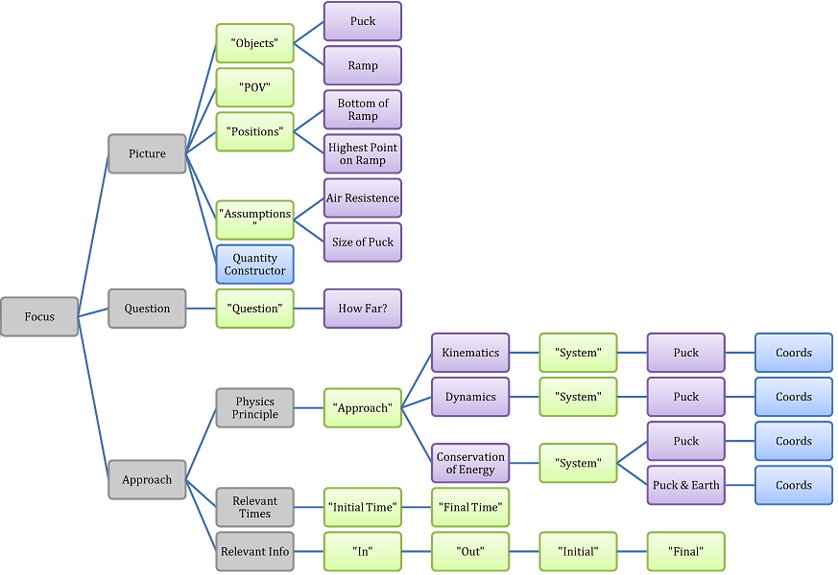
General Coach Design
Our coaches follow the Minnesota model for problem solving.
Pictured is just the “focus” part of the process.
Other instructors are not locked to this model and may adjust coaches how they see fit.

Slide 12
Program Design
Clients
Instructor
Server Host
Adobe Flash Player and internet connection
Java Web server
Apache Tomcat
MySQL database
Students
Version 1 required programming knowledge.
Difficult editing or changing of existing coaches.
New graphical user interface (GUI) designed to construct coaches.
Backend data stored in SQL database and accessed through Java web server. (Free software)
Clients access the java client through Adobe Flash. (Free software)
Notes:
How do we increase the flexibility of the design.
We need to know how inflexible the version 1 coaches were.
Needed to know xml and flash programming elements in order to create or edit existing coaches. Very rigid in design.
How do we get around this?
Developed a graphical user interface (GUI) in order to design coaches.
In essence, leave the dirty programming to us, instructors just develop coaches.
All coaches are stored in a SQL database and accessed through a Java web server.
Instructors and students access the java web server using the flashplayer frontend GUI.
One thing to note, all of this stuff is free.

Slide 13
Program Structure Layout
General terms.
“Parent” and “Children” elements
Logic for solving the problems
“Primitive” elements
Anything you would naturally write for a paper solution of a physics problem.
Coordinate system, approach, picture, diagrams, etc.
Students unlock elements by answering questions in the problem solving process.
Notes:
We not only want to improve the flexibility of the base computer science elements of the program but we want to improve the flexibility of the coaches themselves.
We moved towards object oriented programming.
Because of this I want to list some terms that we use to describe some objects in our coaches.
Parent and Children
This is computer science term we adopted. It essentially describes the logic of the problem solving in the coaches. Children are not accessible unless the parent allows it. All of the posed questions to guide students will follow this parent/children structure.
Primitives
These elements describe every part of the solution that you would naturally find on a paper solution of a problem.
Every detail. Coordinate system, equations, mathematical steps, quantity definitions, pictures, diagrams etc.
Students will unlock primitive elements by answering questions within the parent/children logical structure of the problem

